Slide 1
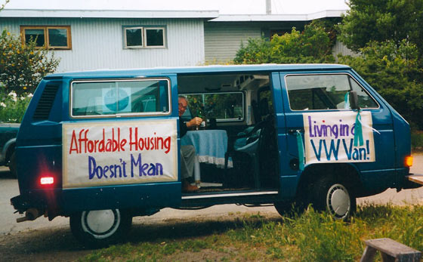
Housing for ALL:
IT IS TIME TO THINK OUTSIDE THE BOX
2014: 113,952 Homeless in California
They are in YOUR community!
Mary Fenelon
MDUUC Social Justice Council
September 27, 2015

Slide 2
HOUSING ECONOMICS 101
MINIMUM WAGE: $9/hr. X 40/hrs. X 4.3 wks./mo. = $1,548 X 30% = $464.40/MO. FOR RENT
- A minimum wage worker would have to work 140 hrs./wk. to pay average rent in CCC
- In CCC, it actually takes $34/Hr. to afford market rate housing in 2013*
SS AVERAGE MONTHLY BENEFIT: $1,300/mo. X 30% = $390/MO FOR RENT**
SSI AVERAGE DISABILITY MONTHLY BENEFIT: $800/mo. X 30% = $240/MO FOR RENT
FOR EVERY 100 EXREMELY LOW INCOME RENTERS, THERE ARE 30 UNITS AVAILABLE
Giving housing to the homeless is three times cheaper
than leaving them on the streets.
- Matthew Yglesias, 2/4/15
*California Housing Partnership Corporation 9/22/15 ; **www.aarp.org 8/14/13

Slide 3
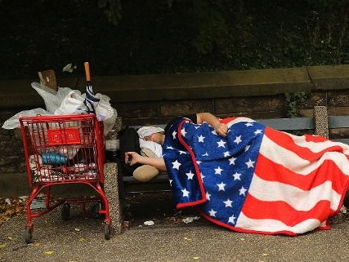
HOW SOME COMMUNITIES “SERVE” THE HOMELESS
Ft. Lauderdale: Illegal to sleep in public/panhandle
Solution: $500 fine/60 days in jail
Philadelphia/Raleigh/Walnut Creek
Ban feeding homeless in public parks
Remove camps/destroy belongings
“the court found that sleeping in public is ‘involuntary and inseparable from’ an individual’s status or condition of being homeless when no shelter space is available”
(Janet F. Bell et al vs City of Boise, 08/06/15)
*The National Memo, 10/07/14

Slide 4
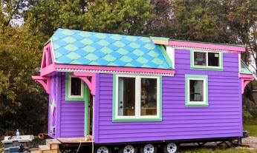
WHAT ARE SOME CREATIVE SOLUTIONS?
Tiny Houses/New Communities
In-law Suites/Multigenerational Housing
Co-housing/Shared Resources
Single Room Occupancy (SRO)
Converting Unused Buildings
Shipping Containers
Rent Sharing/Senior Home Sharing
Smaller Apartments
Mobile Homes/Manufactured Homes
Housing on Religious Community Property

Slide 5
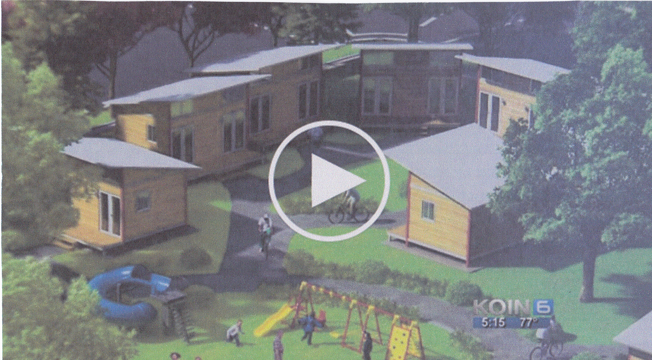
MICRO COMMUNITY CONCEPTS – PORTLAND, OR
FACILITY
- 192 sq. ft.
- Kitchen, bath, futon couch
- 25 units + administrative/laundry buildings
HOW ITS DONE
- Public land
- Build in 2 – 4 days
- Recycled materials
- Costs $12,000 to build
- Rents for $250/$350 month
WHAT IT DOES
- Safe, clean, affordable places to live
- Provides community
- Half of rent will finance next community

Slide 6
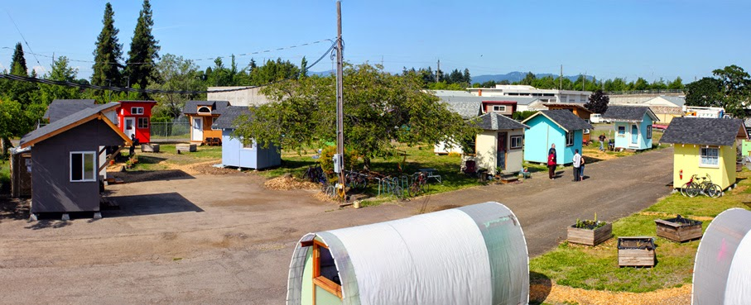
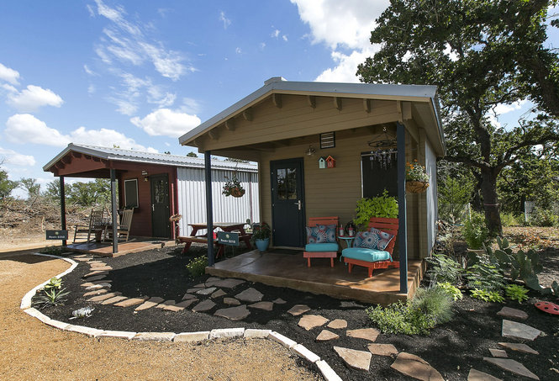
OPPORTUNITY VILLAGE - EUGENE, OREGON
COMMUNITY FIRST HOUSING – AUSTIN, TEXAS
OPPORTUNITY VILLAGE – Intentional Village
- Public Works Parking Lot/City Lease
- 18 Units/30 People
- Under 100 Sq. Ft.
- Separate kitchen, bathhouse, front office
- Less than $70,000
- Resident involvement: 10 hrs. volunteer staffing; village council; manual as community guide
COMMUNITY FIRST HOUSING
- 27 Acre community; tiny homes, trailers, tepee
- Medical, mental health clinic; community garden, wood working shop,
movie theater
- Built w/private funds
- Loaves and Fishes
- Tenants pay minimal rent

Slide 7
IN-LAW UNITS (aka GRANNY FLATS, GUEST HOUSES)
2003 STATE LAW: Cities must permit them
Advantage: Bypass city planners, work directly with building staff for permits
LIMITATIONS: (Example: Walnut Creek)
- Size: 1 BR, 700 sq. ft., second story setback, 10 ft. from property line
- Off street parking
- Architecturally compatible
- Property owner must reside on the property
- Limited number permitted in any given neighborhood
ADVANTAGES:
- Family close by, seniors may help out
- Health care cost saving
- Help with mortgage payments
- Lower rent for seniors/boomerang children
HAZARDS:
- May need to rethink family roles

Slide 8
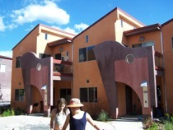
CO-HOUSING/COOPERATIVES
SPECIFICATIONS:
- Individual units w/shared community activities, including some meals
- Clustered housing w/shared green space
- May be apartment, condos, houses, repurposed buildings, mixed use
- Participatory management
- May be rentals or for sale
- May be for specific communities: seniors, families, singles, low income
ADVANTAGES:
- Can be developed w/o city planner step, work directly with building specialists for permits*
- Community lifestyle
- More housing/amenities for the $
*2003 state law
*2013 State Law

Slide 9
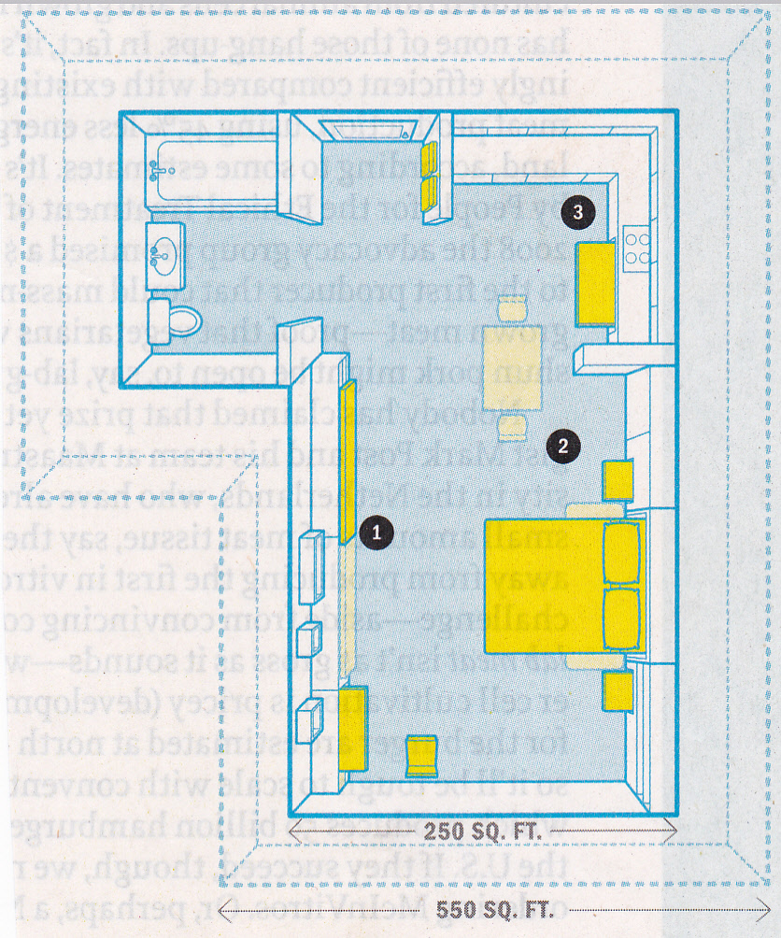
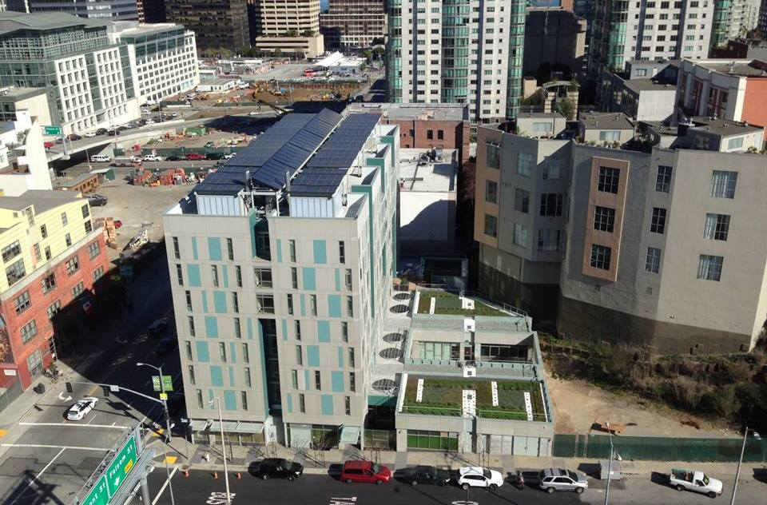
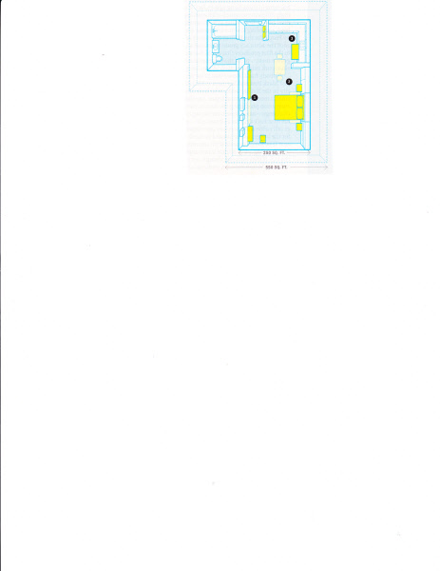
MICRO APARTMENTS – MANHATTAN/SAN FRANCISCO/VANCOUVER
FACILITY*
250 Sq. Ft., fold-a-way furniture, a la Murphy bed
High ceilings allow more storage, large windows, illusion of space
HOW ITS DONE
- Change zoning laws
Space + utility + functionality + aesthetic inspiration
Reduce rents
RENE CAZENAVE APARTMENTS**
Subsidized housing for formerly homeless
FACILITY
- 375 Sq. Ft., studios and 1-bedroom units, 10 % handicapped
- Support services 5 days
- Trans Bay Redevelopment Area
*Time, 3/25/13
**San Francisco Chronicle Home Design, 9/14; www.renecazenaveapartments.com

Slide 10
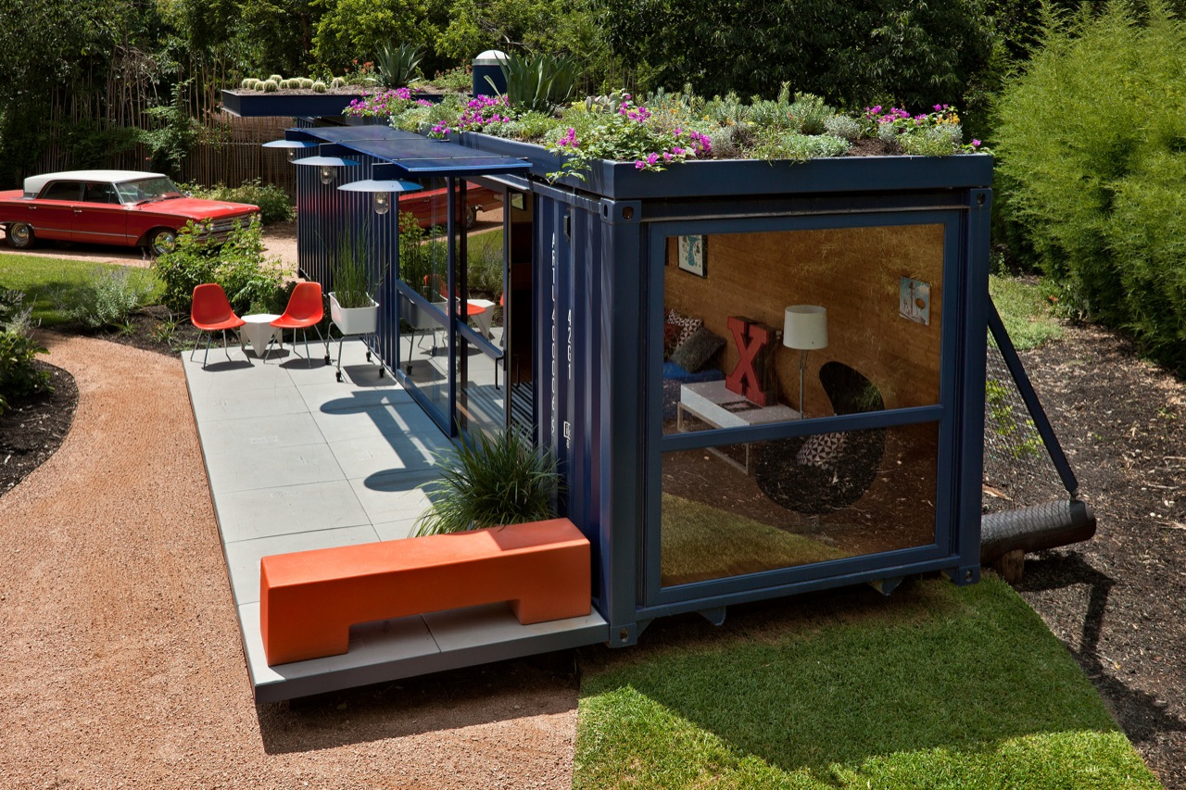
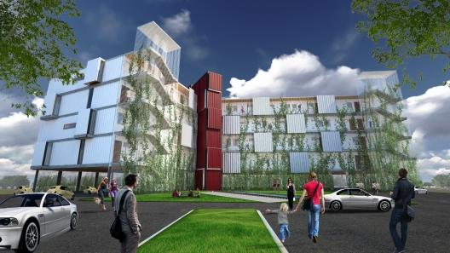
SEA CONTAINER HOME – SAN ANTONIO; GREENVILLE, SC; WASHINGTON, DC
FACILITY:
- Sea shipping container, 8 ft. x 40 ft.
HOW IT’S DONE:
- Foundation: Repurposed telephone poles
- Green roof, grey water, compostable toilet
APARTMENT BUILDING:
- Stacked and side by side
WHAT IT DOES:
- Reduces energy consumption
- Reduces environmental impact
- Solar in larger installations
*www.poteetarchitects.com; www. travispricearchitects.com

Slide 11
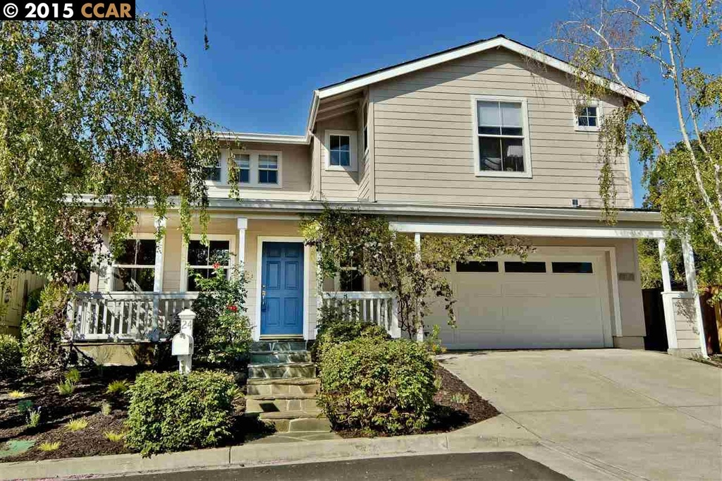
SHARED HOUSING
WHAT IS IT? Two or more unrelated people sharing a home
Shared Housing:
Homeowner rents room(s), perhaps for services in return
Shared Living Residences:
Group homes, cooperative/communal living, may have support services
ADVANTAGES:
Utilizes resources efficiently: maximizes housing stock
For owners: stay in place, perhaps have assistance
For renters: lowers housing costs
Social interaction, companionship, security
Aids in neighborhood stability
Saves on health care costs
MARKET:
- 11.2 million seniors live alone*
- Older population will double from 2010 to
2030
*2011 Census

Slide 12
AFFORDABLE HOUSING ON FAITH COMMUNITY PROPERTY
St. Paul’s Episcopal Church, Walnut Creek
IDEA: APARTMENTS BUILT OVER HOMELESS DAY CENTER
- Day center for single adults
- Offers meals, showers, laundry, clothing shed, food pantry, support services
- All guests are registered, issued IDs
REBUILDING:
- Services on main floor
- 50 studio, one bedroom apartments upstairs
NEED:
- Congregational buy-in
- City support, including police
- New non-profit organization
- Relationships w/Other NPOs and faith community support

Slide 13
A ROOF OVER EVERYONE’S HEAD
APARTMENT PROPERTY OWNERS PARTNERSHIPS
(Nashville, Seattle, Others)
IDEA: Multifamily developers and property owners to set aside one apartment per building for low income renters.
COUNTY/CITY PROVIDES:
- Rent guarantee through Section 8, VASH, etc.
- County/city signs lease with apartment owner, then signs lease with client
- Ongoing social service support for the client, including preparing client for move in
- Landlord given 24-hour telephone contact for emergencies
NEED:
- “Champion” within the industry to assist in obtaining buy-in
- Continual marketing, particularly social media
- Flyers with a “heart” story
- Appeal: Helping the community

Slide 14
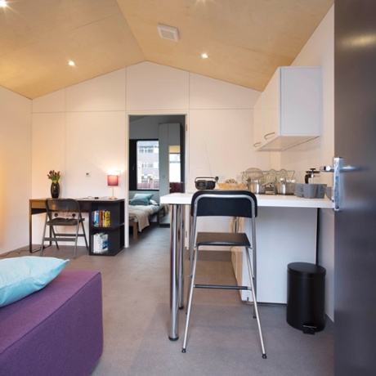
SOME OTHER IDEAS
CONVERTED TROLLEY CARS/REYCYCLED MATERIALS, ETC.: Explore non-traditional ideas
COOPERATIVE APARTMENT HOTELS:
- Positives: Many services on site, no long term commitment
Negatives: Loneliness, lack of personality in a confined space, “no where to call home”, hotel address not considered a permanent address
MANUFACTURED HOMES (INCLUDING “TRAILERS”): Many sizes, own the home and rent the space. ($12,000 +)
LAND BANKING: Establish Community Land Trusts to help make property available for low income housing.
*www.ymcalsw.org/ycube –London YMCA: Self-contained, 280 Sq. Ft., eco-efficient materials, stack/attach, factory built, pre-constructed, plug and play, plumbing/electricity/heating, cost $50,000, rents @ 65% mkt. rate

Slide 15
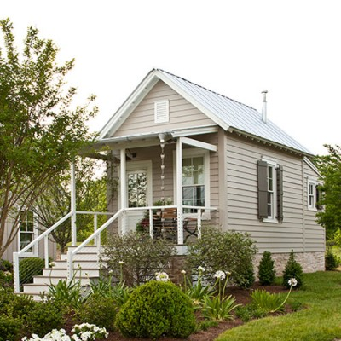
WHAT YOU CAN DO
ADVOCACY:
- Find out who is ill housed in your community
- Find out who are the advocates/service agencies addressing their needs
- Speak at city council, board of supervisors and planning commission meetings
- Go to lobby days in Sacramento
- Contact your assembly person and senator; visit them to discuss your concerns
- Write letters for the op ed page of your local newspaper
- Sign and circulate petitions
- Follow the Housing Element process in your community

Slide 16
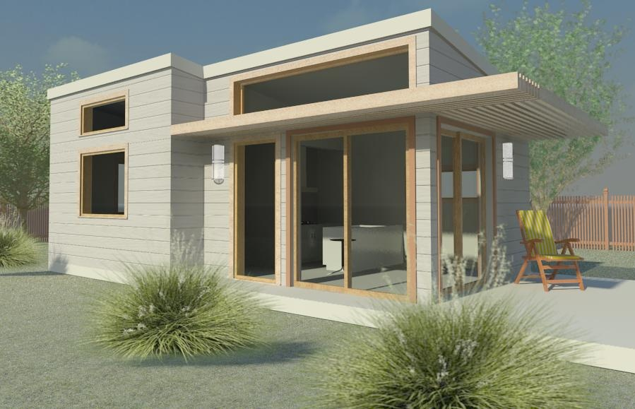
HOW TO INVOLVE YOUR ORGANIZATION!!
Find a justice buddy,
Two of you find another justice buddy,
Pretty soon you have a Justice Circle
HHousing
Housing Justice
HOUSING JUSTICE IS A MEANS TO AN END, NOT THE END – Rev. Dr. Phil Lawson

